Slide 1
University of the 21st Century
CREATIVE

Slide 2
CREATIVE
UNIVERSITY
21st CENTURY

Slide 3


FUTURE | can go both ways

Slide 4

EITHER WAY | how do we prepare the population?

Slide 5

Coping with |UNCERTAINTY|

Slide 6

Making the |TRANSITION|

Slide 7






CHALLENGES| for universities world-wide
Increasing DEMAND for higher education
INTERNATIONALISATION of education and research
University – Industry COLLABORATION
-10
proliferation of PLACES where knowledge is produced
REORGANISATION of knowledge
emergence of new EXPECTATIONS
2003-2013
European Commission

Slide 8
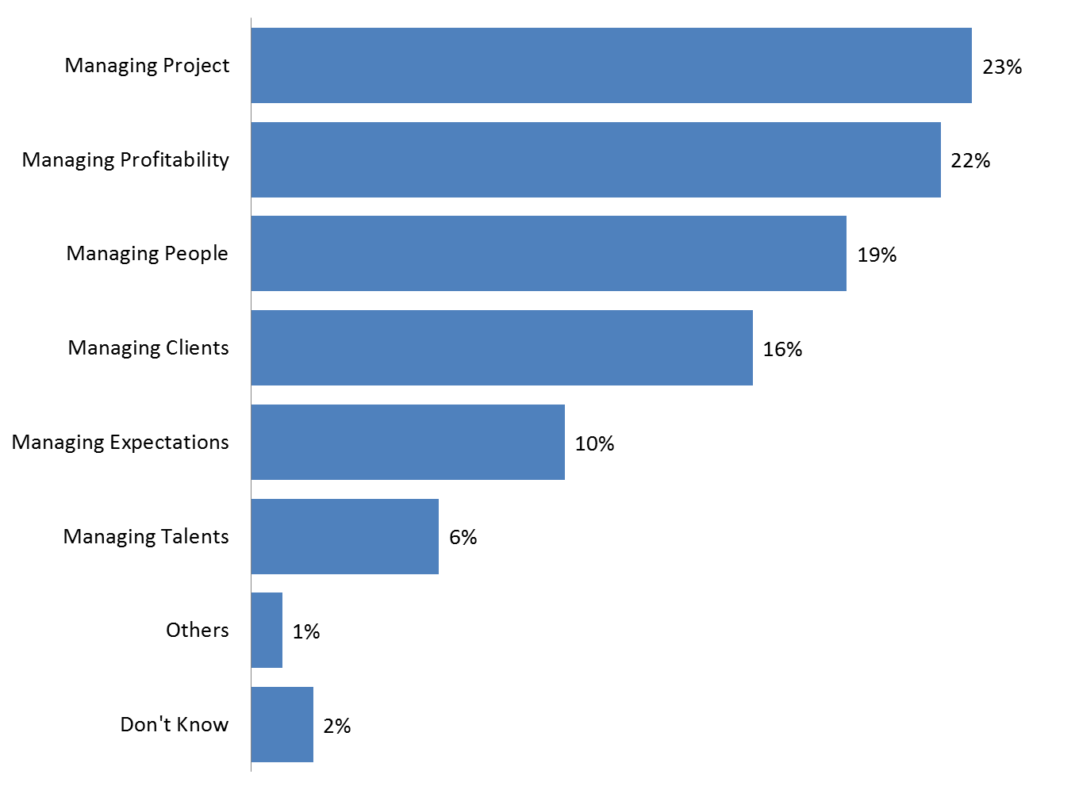

CRITICAL SKILLS | are the much needed skills?
Over the PAST FIVE YEARS which of the following has been the most important management skill at your company?
-05
2003-2008
Economist Intelligence Unit (EIU) study commissioned by PMI in 2008

Slide 9
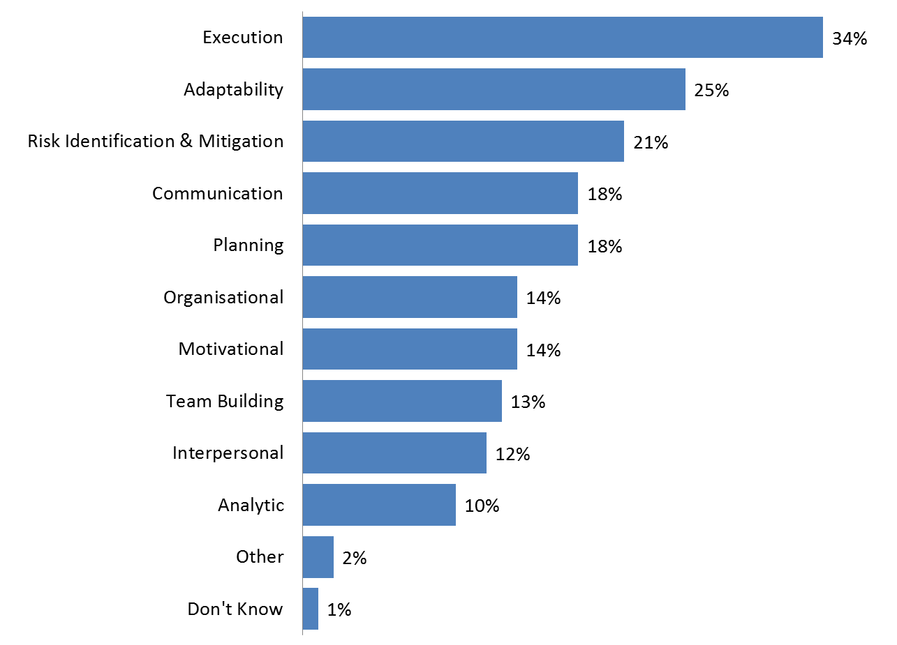
CRITICAL SKILLS | are the much needed skills?
Over the NEXT FIVE YEARS, which of the following skills will be most important to your company’s success?
+05
2008-2013
Economist Intelligence Unit (EIU) study commissioned by PMI in 2008

Slide 10

CHALLENGES| USA Survey
According to the National Association of Colleges and Employers (NACE), USA, Job Outlook 2010 survey:
  1. Communication Skills
  2. Analytical Skills
  3. Teamwork Skills
  4. Technical Skills
  5. Strong Work Ethic
2010
AUGUST 26, 2010, 10:00 AM ET

Slide 11

CHALLENGES| Malaysian survey
A study conducted by the Federation of Malaysian Manufacturers (FMM) on reasons why graduates unemployed:
  Lack of industrial training
  Poor communication skills especially poor command of English language
  low problem-solving skills
  lack of self-confidence
  Poor work attitude
2010
Saturday February 27, 2010 MYT 9:11:00 PM

Slide 12
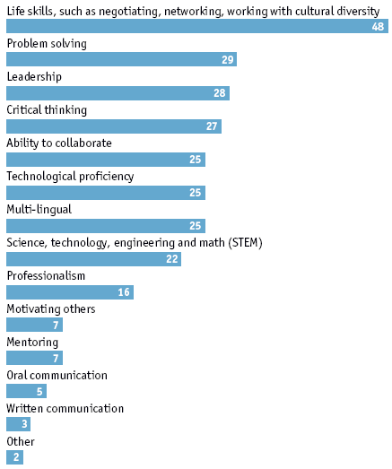
CRITICAL SKILLS | are the much needed skills?
In your opinion, which skills will be in most demand from employers OVER THE NEXT DECADE? Select up to three. (% respondents)
21st
Century and beyond
2009

Slide 13

We NEED our population be able to…
PERFORM
THE REQUIRED TASKS
SURVIVE
THE DISTRUPTIVE CHANGE

Slide 14


ROLES | of universities are changing
Over the decades, fundamental roles of universities are CREATING, PRESERVING, INTEGRATING, TRANSMITTING, AND APPLYING KNOWLEDGE. While these fundamental roles of the university do not change over time, the particular realisation of these roles do change—and change quite dramatically, in fact.
‘DIGITAL’ GENERATION learners approach learning in a different way. Unaccustomed and unwilling to learn sequentially—rather inclined to PLUNGE IN and LEARN THROUGH PARTICIPATION AND EXPERIMENTATION.

Slide 15

CONNECT | COMMUNICATE | COLLABORATE |

Slide 16
POWER HOUSE| Universities plays a vital role in preparing the global population
CREATIVE
Delivering programmes that are highly innovative
Producing graduates that are ready for the jobs that are not even created
Solving problems that are yet to exist
Using tools and techniques that are yet to be developed

Slide 17
NEEDED over and above existing competency to SURVIVE
REQUIRED Fundamental competency to PERFORM

Slide 18
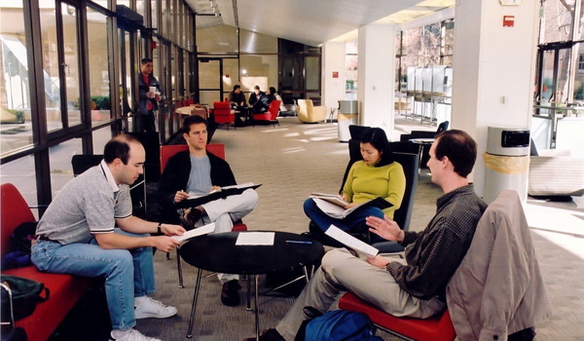
faculty members of the 21st Century university will be asked to set aside their roles as teachers and instead become DESIGNERS OF LEARNING EXPERIENCES, PROCESSES, AND ENVIRONMENTS.
they may be asked to develop collective learning experiences in which students work together and learn together with the faculty member becoming more of a CONSULTANT OR A COACH than a teacher.

Slide 19

faculty members MUST move in-line with the change
CONNECT | COMMUNICATE | COLLABORATE |

Slide 20


Regulators MUST move in-line with the change
BRICKS CLICKS

Slide 21
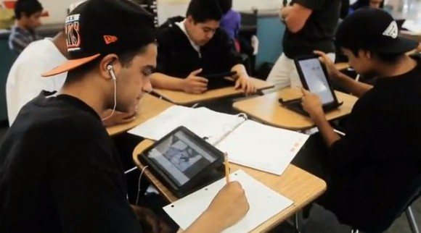
University MUST move in-line with the change
BOOKS DEVICES

Slide 22
CHALLENGES| being creative
INDUSTRY Linkage
INDUSTRY Players
PLAYERS Commitments
COLLECTIVE DESTINY
UNIVERSITY
POLICIES and PROCEDURES
PERSONNEL Academic and Non-Academic
REGULATORS
POLICIES and PROCEDURES
PERSONNEL

Slide 23
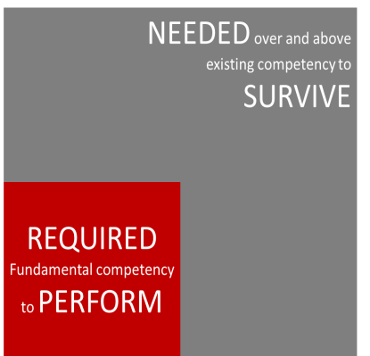
SUMMARY
FUTURE
UNCERTAINTY
POPULATION
COLLECTIVE DESTINY
CREATIVE UNIVERSITY
21st century

Slide 24
THANK YOU

