Slide 1
Creative University of the 21st Century
World class expertise for local solutions
Building Technocratic Leaders in Healthcare
Joseph Antoun, MD, MS, MPP
03|12| 2012 ·Almaty

Slide 2
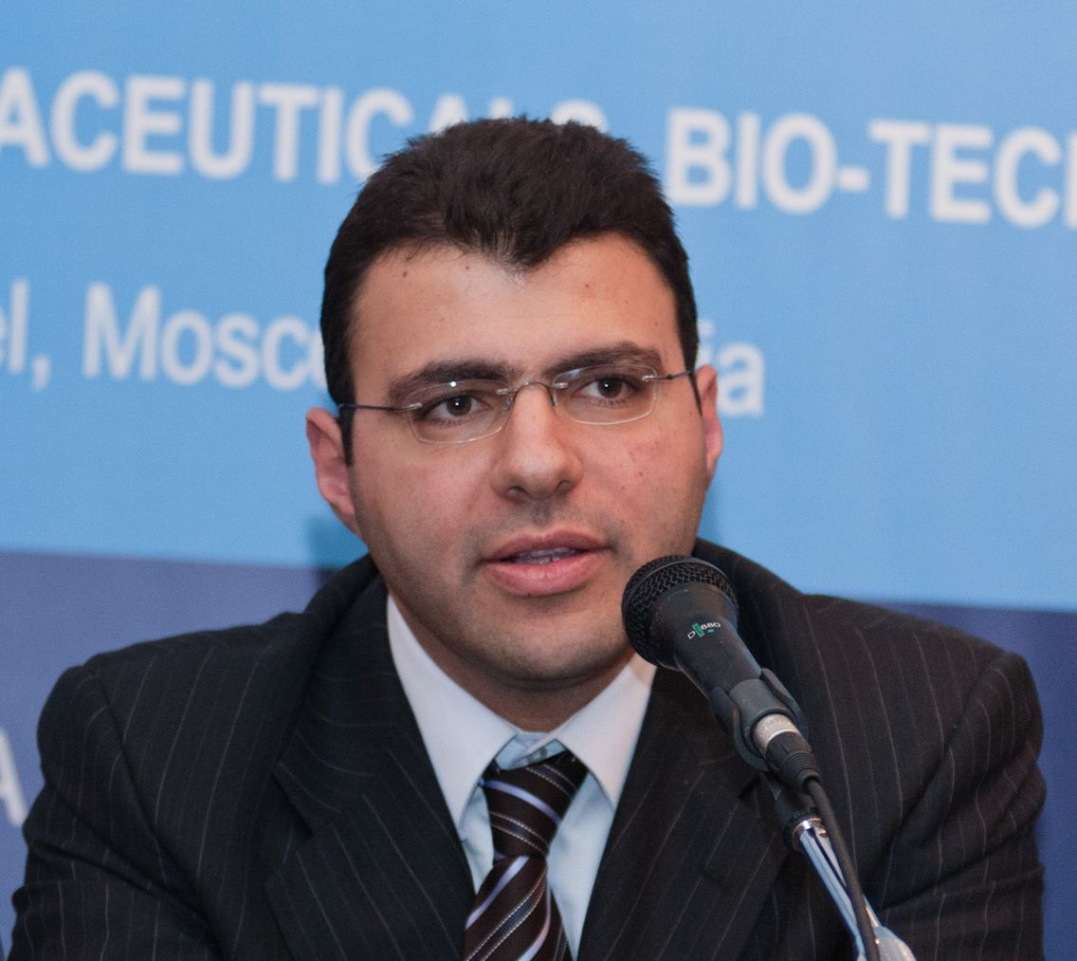
Who am I?
Joseph Antoun
Co-Director, Center for Health Policy at U of Chicago
Health Systems, Leadership and Negotiation
Professor of Health Policy at Buck Institute in California
CEO of Health Systems Reform (HSR)
Research Fellow at London School of Economics
MD, MS, MPP: Harvard, Hopkins, St Joseph

Slide 3
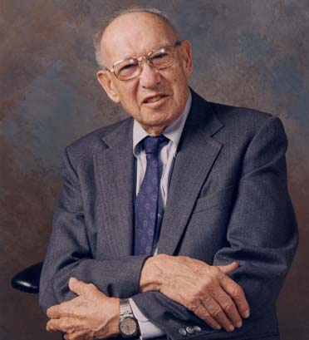
Creative University of the 21st Century
My angle of interest is:
‘What type of healthcare professionals do we need to develop for the 21st century?’
Shall we develop technocrats when we need technocratic -leaders in healthcare?
Shall we develop local experts or global ones?
Shall we develop specialists or general practitioners
Are we matching supply of healthcare workforce with demand based socio-epidemiological determinants?
“The best way to predict the future is to create it.”
Peter Drucker
world class expertise for local solutions . www.healthsystemsreform.com

Slide 4
Building Technocratic–Leaders in Healthcare
Leadership in Healthcare
Negotiation in Healthcare
Communications (+English or Medical English)
Global Health
Technology in healthcare
Health Economics
Health Financing & Insurance
Health System Management
Cost-Effectiveness Analysis
Health Policy and Advocacy
Health Systems & Systems Reform
AMA and Obama Reform
world class expertise for local solutions . www.healthsystemsreform.com

Slide 5
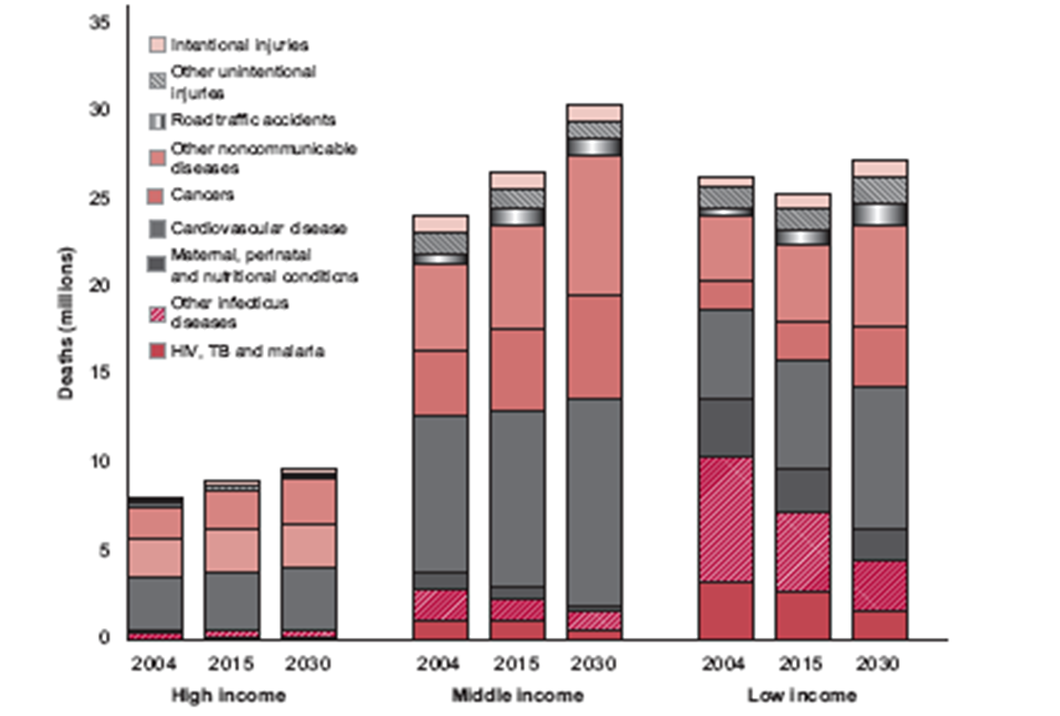
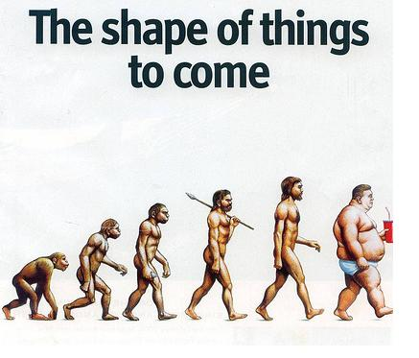
Example: Double Burden of Diseases in Transitioning Countries
December 13th, 2003
The shape of things that are here!!
world class expertise for local solutions . www.healthsystemsreform.com

Slide 6
Health Policy Studies in the US
n engl j med 364;8 nejm.org February 24, 2011
D. Mou, et al., "The State of Health Policy Education in U.S. Medical Schools," n engl j med, March 10, 2011 364:e19
world class expertise for local solutions . www.healthsystemsreform.com

Slide 7
The Knowledge Cycle & Research Capabilities within a 21st Century University
International
Local
Transferability & Knowledge Adaptation
Knowledge Translation
Capacity Building
Coaching
Education
Training
Knowledge Generation
Evidence Based Decision Making
Implementation
Research
Local Research & Knowledge Generation
Reform
Review
world class expertise for local solutions . www.healthsystemsreform.com

Slide 8
In Conclusion
Healthcare currently requires new skills beyond the biomedical approach to care.
Physicians are at the center of the healthcare transaction and main drivers of health system costs and health outcomes: should be trained as leaders in healthcare
Arabs call a physician ‘the Wise’…. it is time to train them as such!
world class expertise for local solutions . www.healthsystemsreform.com

Slide 9
Thank you!
World class expertise for local solutions
02|12| 2012 ·Almaty

